Slide 1
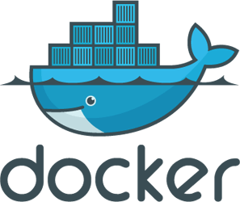

Introduction to Docker

Slide 2
Agenda
What is Docker
Why is it a Hype
How can I benefit from Docker
Docker in Context of DevOps
Docker in Context of Microservices
How can I benefit from Docker

Slide 3
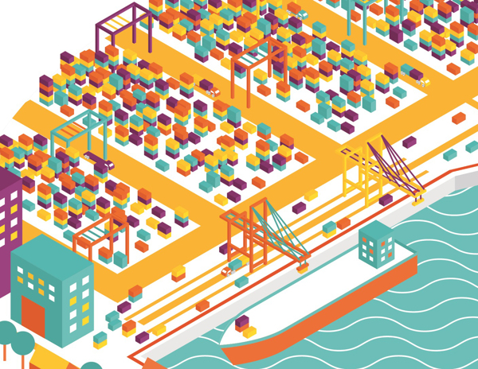
What is Docker

Slide 4
Docker is an open platform for developers and system administrators to build, ship, share and run distributed applications
Notes:
Lets break down what this Buzzword sentence into pieces.
Docker allows you to package an application with all of its dependencies into a standardized unit for software development.

Slide 5
Docker is an open platform for developers and system administrators to build, ship, share and run distributed applications
Notes:
And start with Build. Later we are going to take a look the developer and sysadmins.
Why Build? I might ask my programming language already produces a build.

Slide 6
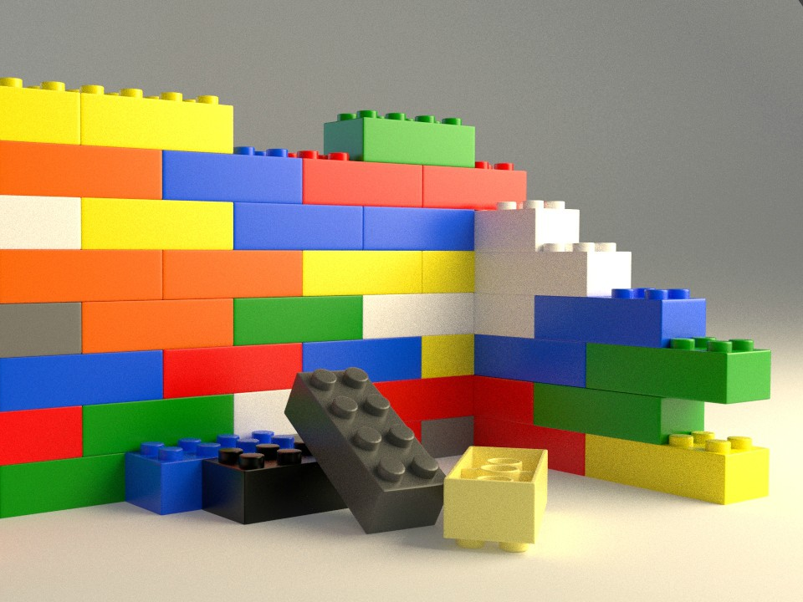
Build
Every programming language or framework produce different outcomes
Notes:
The problem is that If you build a program in Java you get a JAR or WAR or EAR file. in GO it will be binary, in Node, PHP, Python something else,
So every programming language is producing something different. Docker allows us to provide a unified wrapper around that that will work for all possible applications.

Slide 7
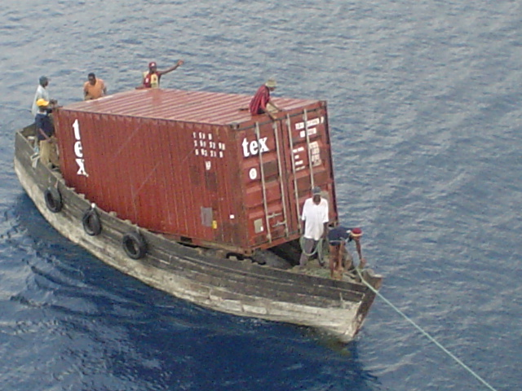
DIY Docker style build packaging
Put everything in a ZIP file and go
Notes:
If you would do it yourself how would you approach it? You would probably put everything into a zip file and ship that. If you are smart you would do an installer.

Slide 8
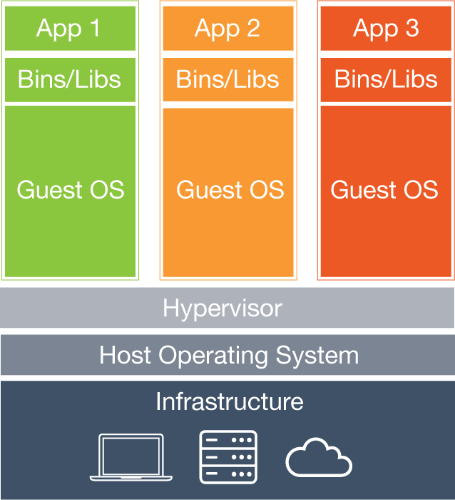
Draw the line
Notes:
The problem is where you would draw the line? I might be tempted to put it on the operating system.
But then you would have to maintain the operating system and you must be absolutely sure that all your operating systems are the same.
So the operating system would not be under your control.

Slide 9
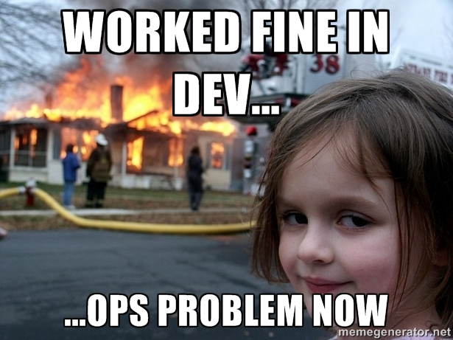
Agenda
Notes:
Or this will be the result

Slide 10
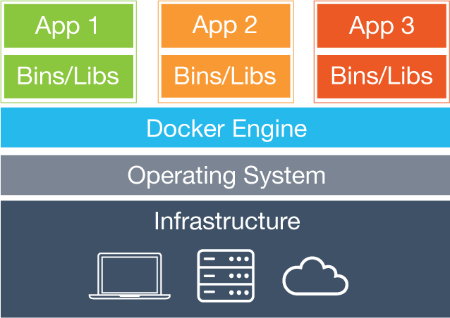
VM vs. Docker
Notes:
Containers include the application and all of its dependencies together,
The only common thing is the shared kernel from the OS.
Container run as an isolated process in userspace on the host operating system.
The result is that you are able to put everything your application need into the package, except of the kernel.

Slide 11
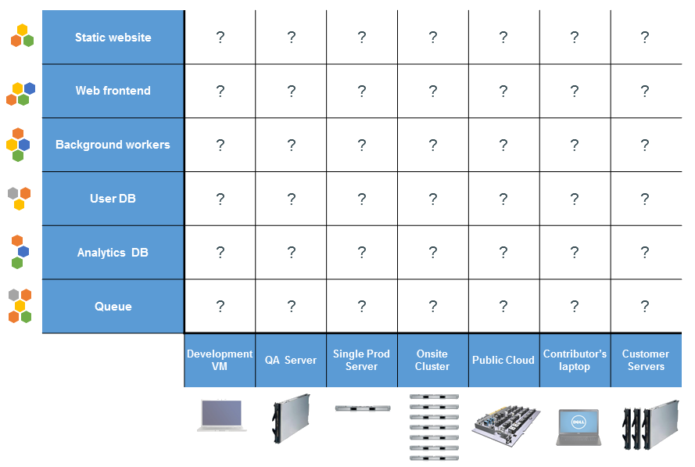
The Matrix from Hell

Slide 12
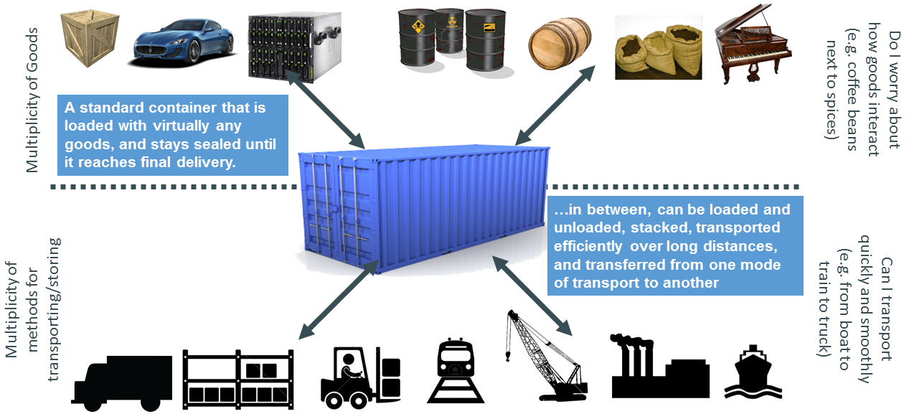
Container Standard

Slide 13
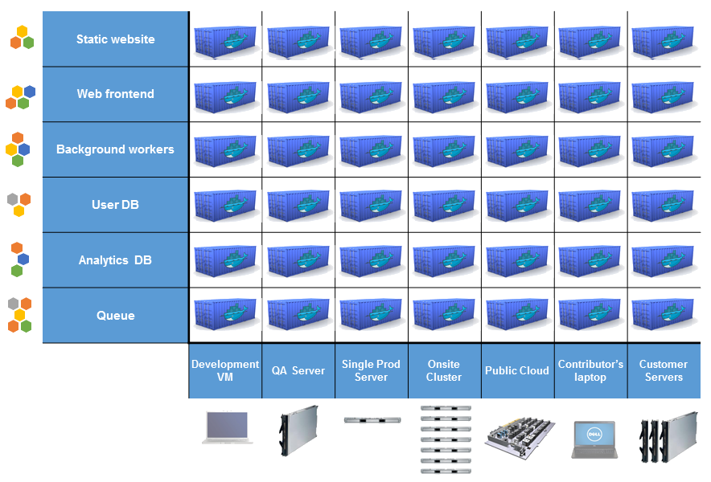
Containerize everything

Slide 14
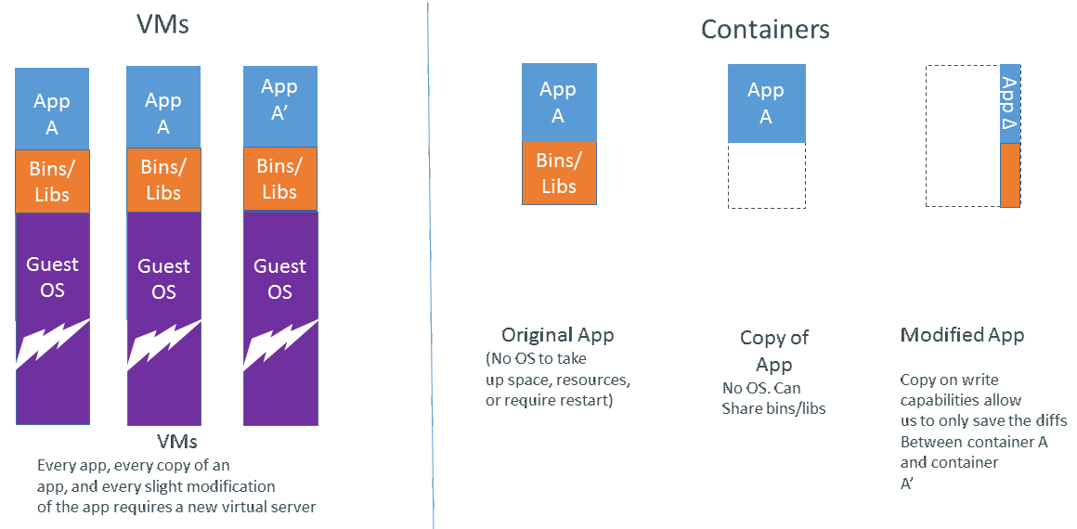
Less resources

Slide 15
Creating an Image

Slide 16
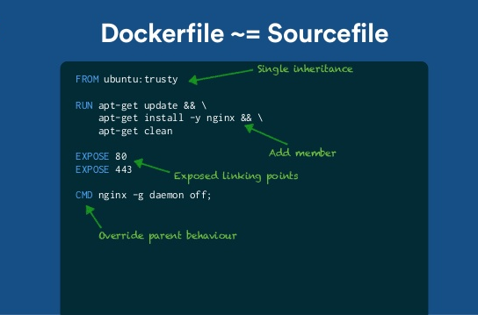

Slide 17
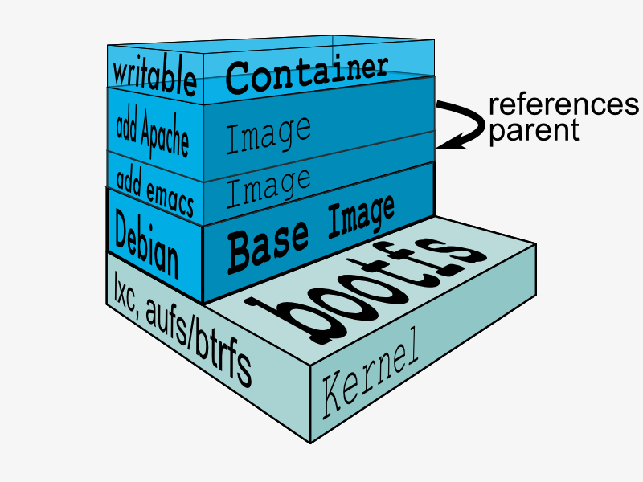
Image layers

Slide 18
Docker is an open platform for developers and system administrators to build, share, ship and run distributed applications
Notes:
Now that we have build an Image we need to share it so we can reuse it on another machine or with another user.

Slide 19
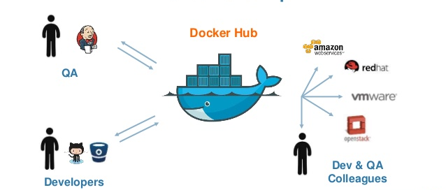
Share
Notes:
This is the part where docker hubs into place. Docker hub is a central repository where you can upload your created image and share it with other users and store them from production.
Docker Hub is also the weakest part of Docker. It is quite complicated to setup a docker hub instance on you infrastructure, but there are many commercial vendors offer a server.
And if you want to make

Slide 20
Docker is an open platform for developers and system administrators to build, share, ship and run distributed applications
Notes:
Now that we have build an Image we need to share it so we can reuse it on another machine or with another user.

Slide 21
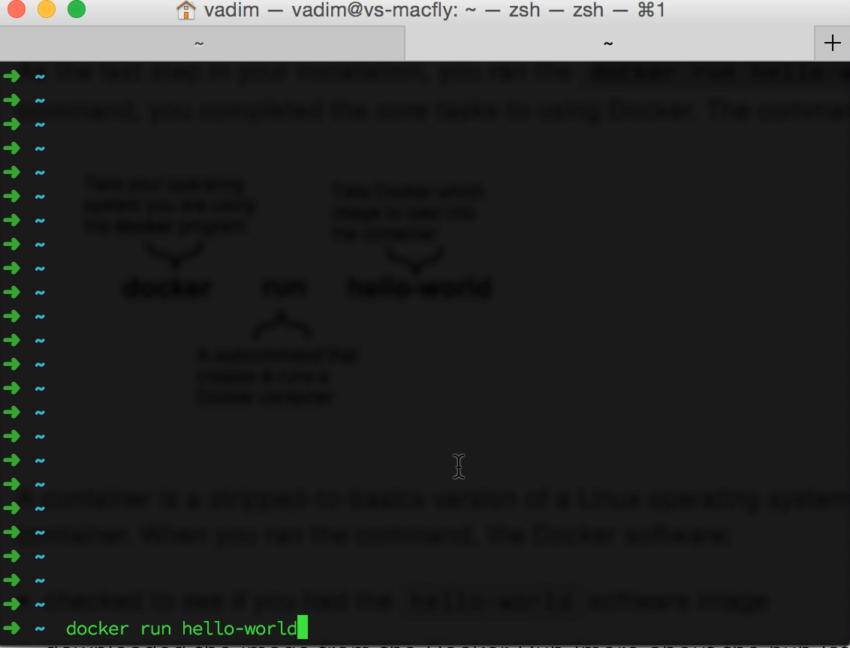
Ship & Run Container
Notes:
Because we already created an container,

Slide 22
Images vs. Container
Image
A snapshot of a disk image. Can be created by commiting a container.
Container
A program running in docker, which uses an image as a base image. Each container start from scratch from the base image.

Slide 23
Advantage of all this
Create fast and easy many applications
Notes:
That do not consume many resources.

Slide 24
Advantages
Portability
Automate Processes
Deliver better quality Applications
Standardize QA, Development, and Production
Rapidly Scales up or Down

Slide 25
Microservices with VMs

